Slide 1
Nautičke karte, tablice, atlasi, dnevnici i ostale neophodne publikacije koje će biti upotrijebljene za planirano putovanje:
Katalog nautičkih karata (Chart Catalogue);
Nautičke karte i bijele karte (Navig. Charts and Plotting Sheet );
Obavijesti za pomorce ( Notices to mariners)
Svjetske oceanske rute (Ocean Passage for the World);
Karte preporučenih ruta i Pilotske karte (Routeing charts or Pilot charts);
Sailing Direction / Pilot Books,
Lista popisa svjetionika i njihovih svjetlosnih karakteristika (List of Light);
Tablice morskih mjena (Tide Tables);
Atlas morskih struja (Tidal Stream Atlases);
Značajne informacije o pomorskim rutama (Routeing Informations);
Popis svjetskih obalnih radio stanica s njihovim uslugama - ALRS

Slide 2
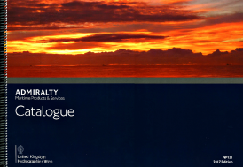
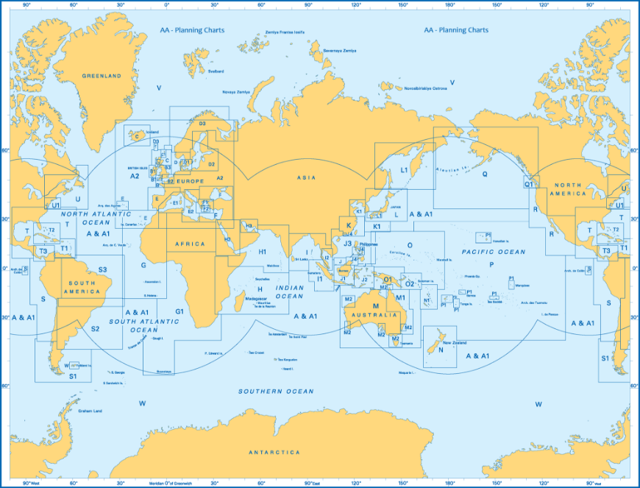

Slide 3
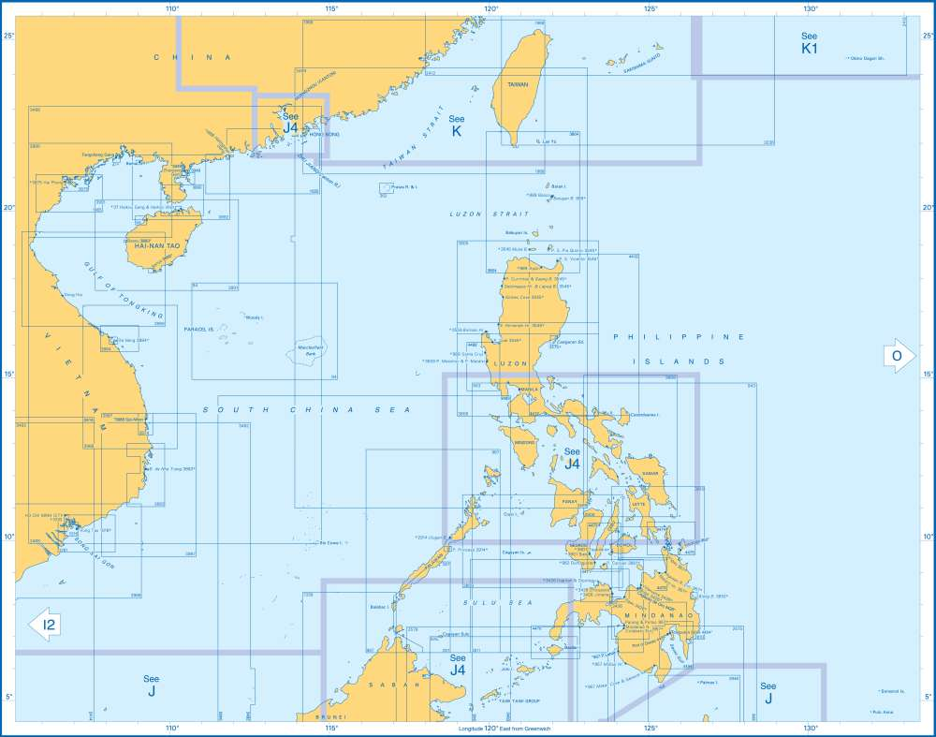

Slide 4
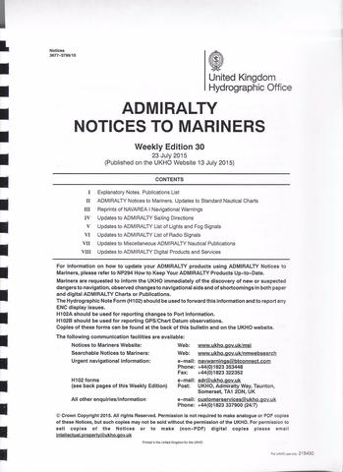

Slide 5
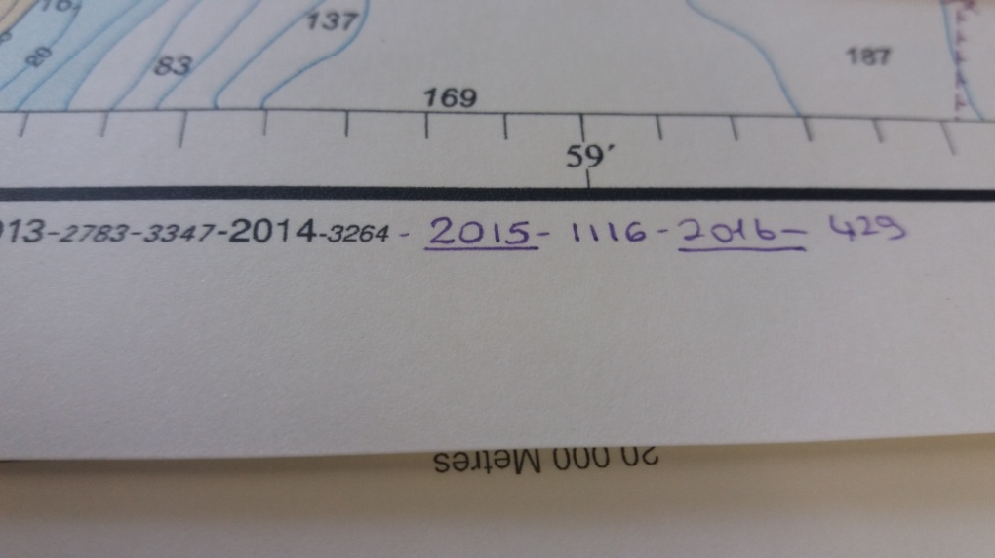
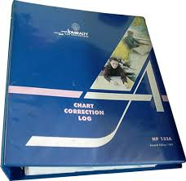
Chart correction log
Oglasi za pomorce (HHI-1 mjesecno)
Notices to mariners (BA- 1 tjedno)
Oprema za ucrtavanje

Slide 6
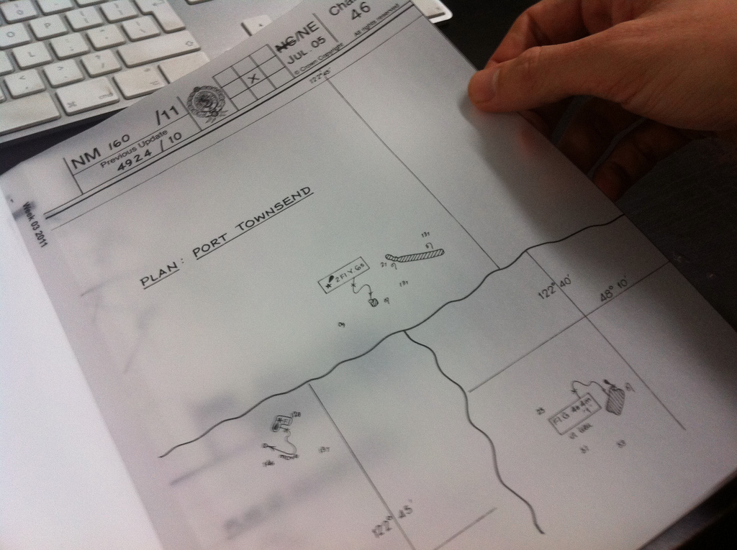
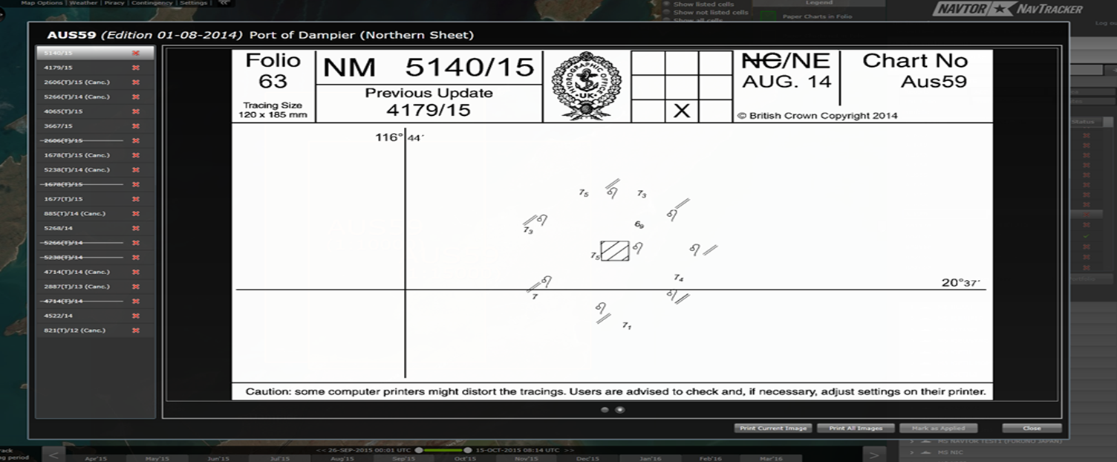

Slide 7
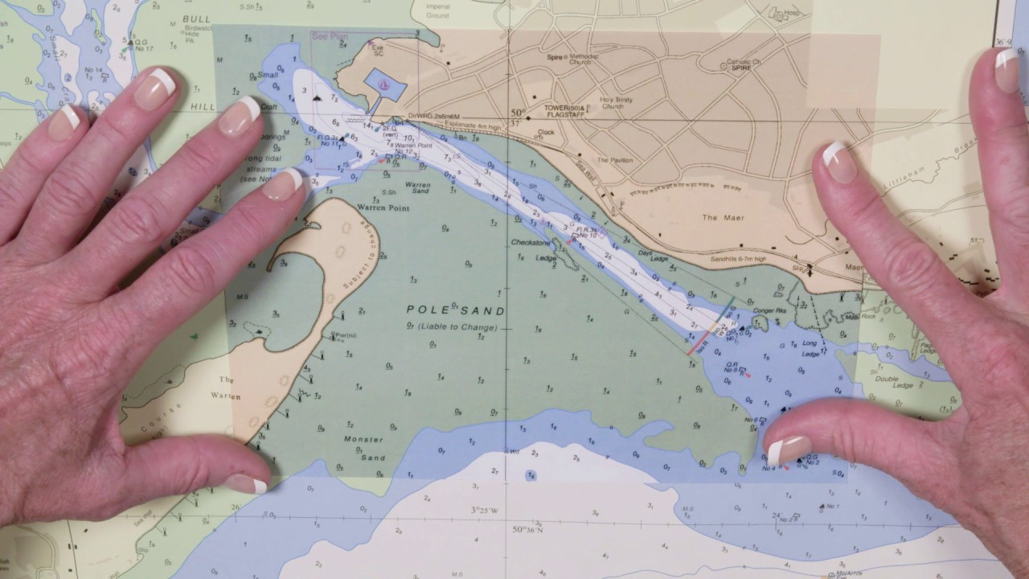
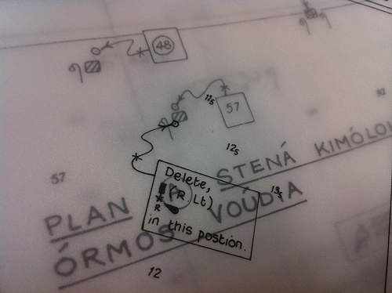

Slide 9
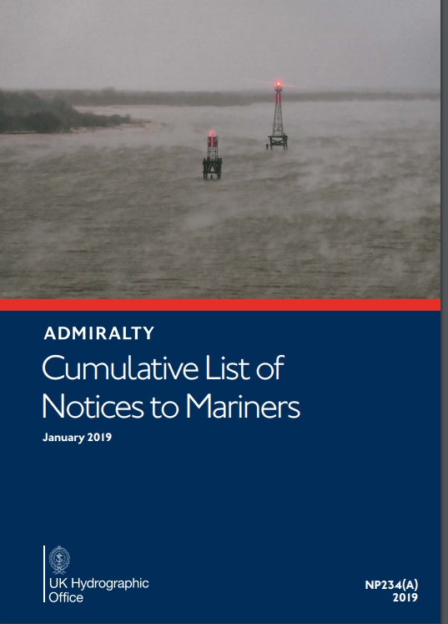
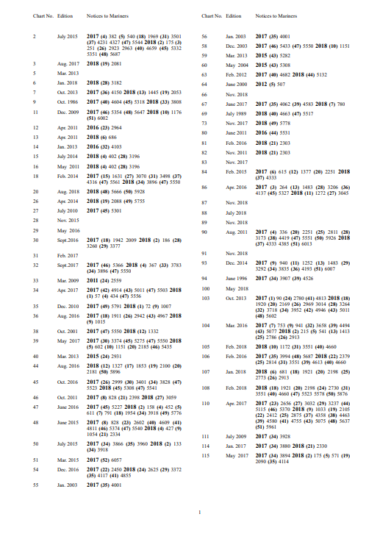

Slide 10
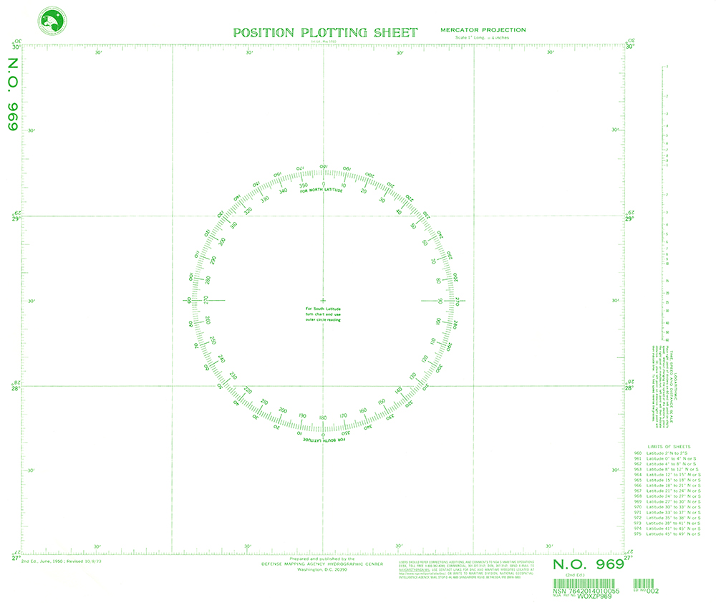

Slide 11
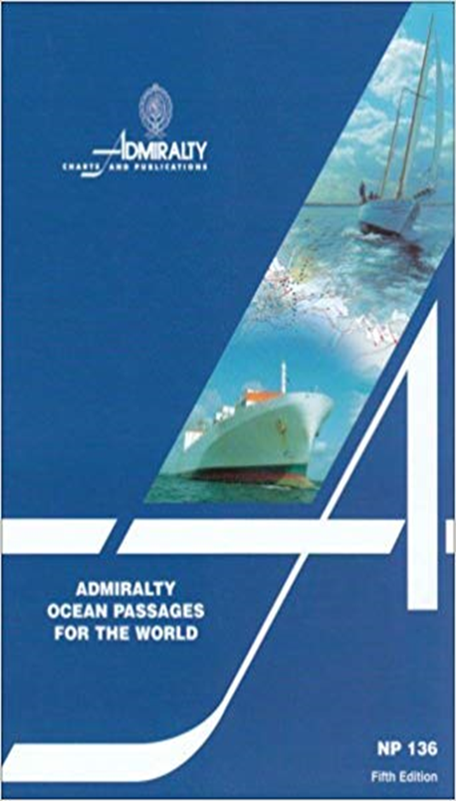
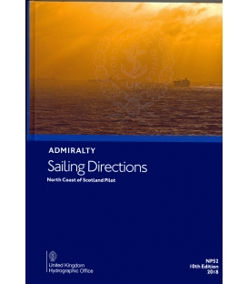
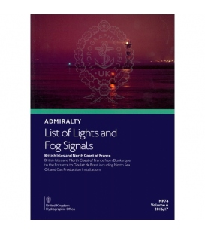
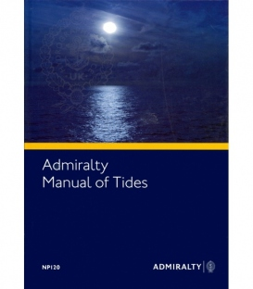
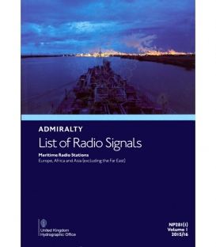
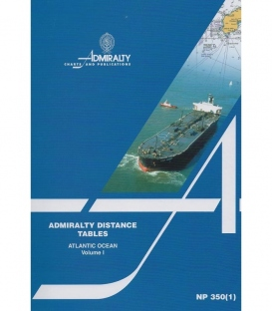

Slide 12

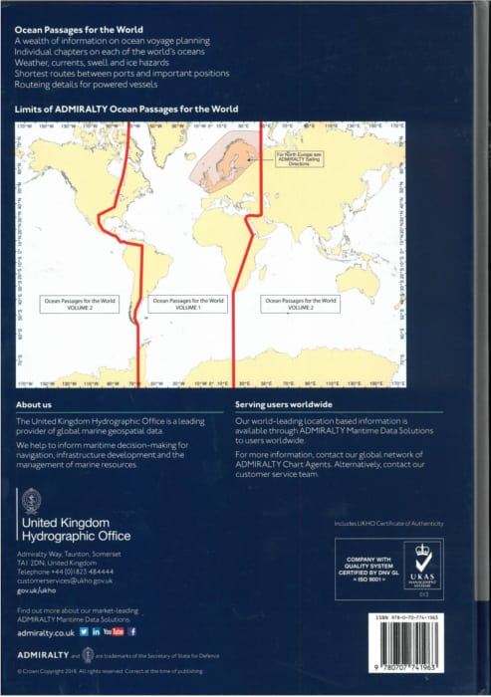

Slide 13
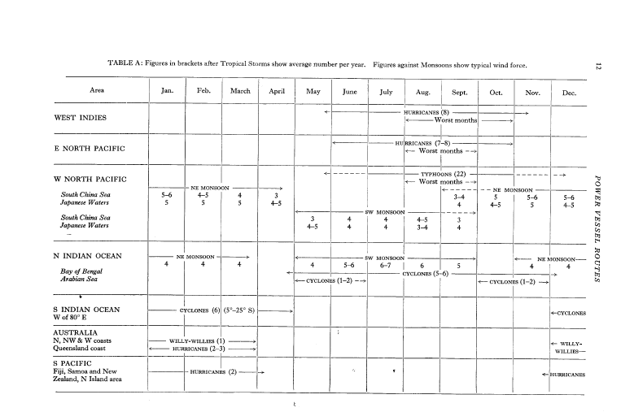

Slide 14
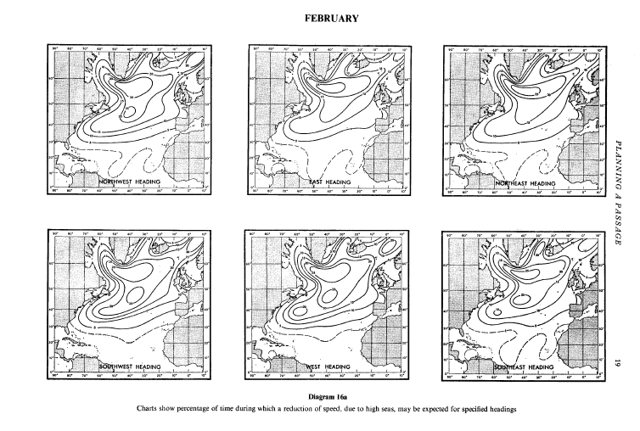

Slide 15
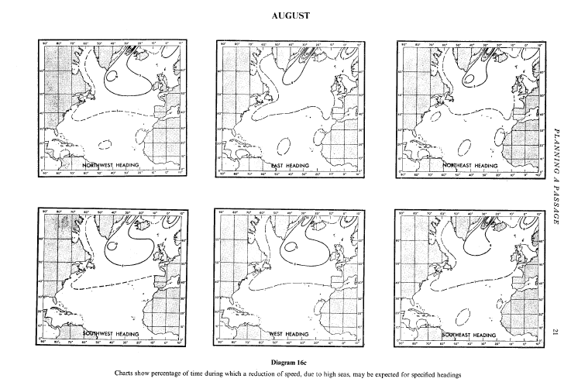

Slide 18
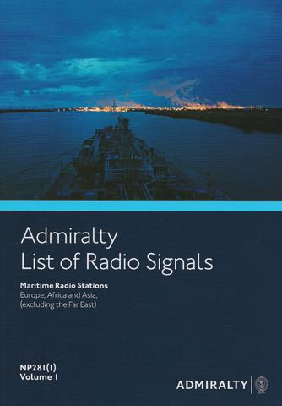
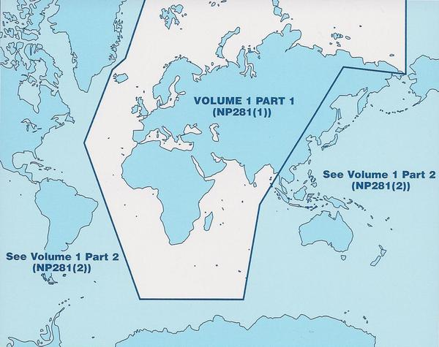
ALRS Vol I
Global Maritime Communications
Satellite Communication Services
Coastguard Communications
Maritime TeleMedical Assistance Service (TMAS)
Radio Quarantine and Pollution reports
Anti-Piracy Contact Table

Slide 19
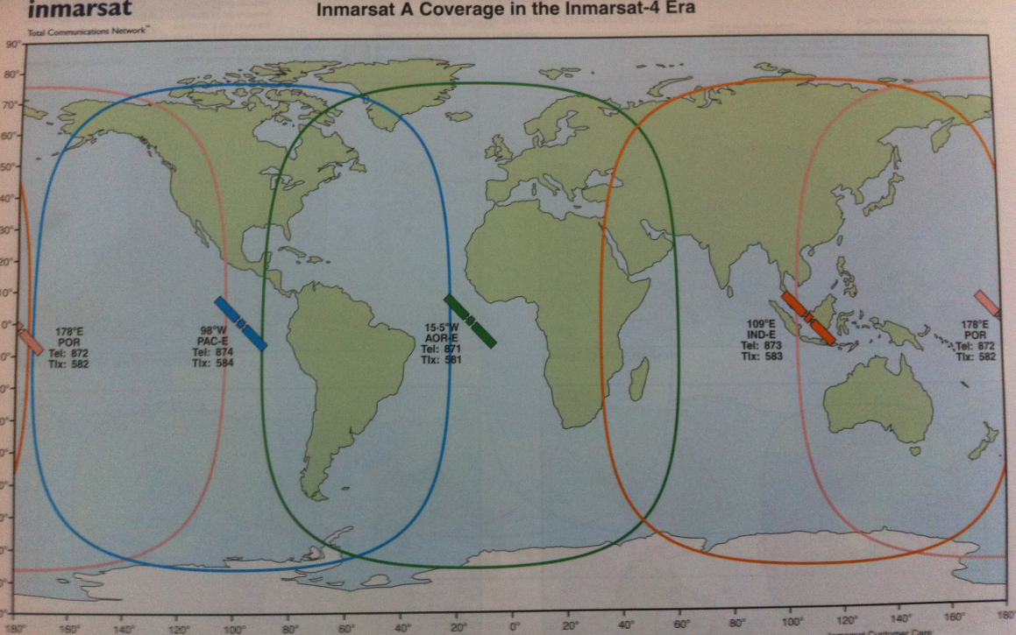
Global Maritime Communications

Slide 20
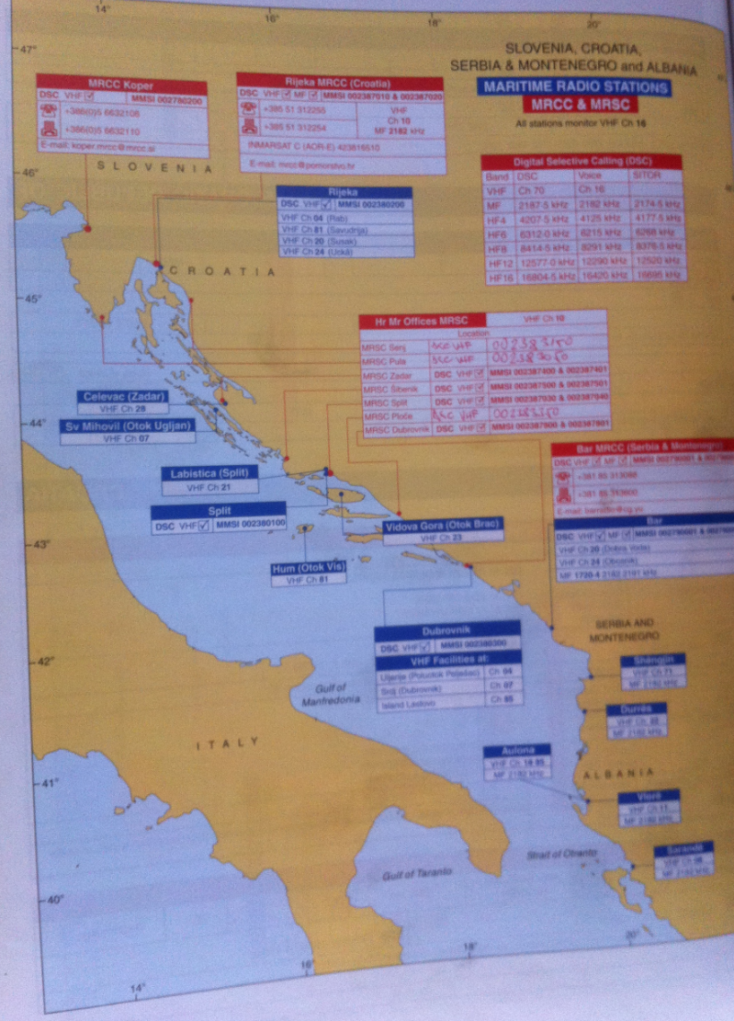
Maritime Radio Stations

Slide 21
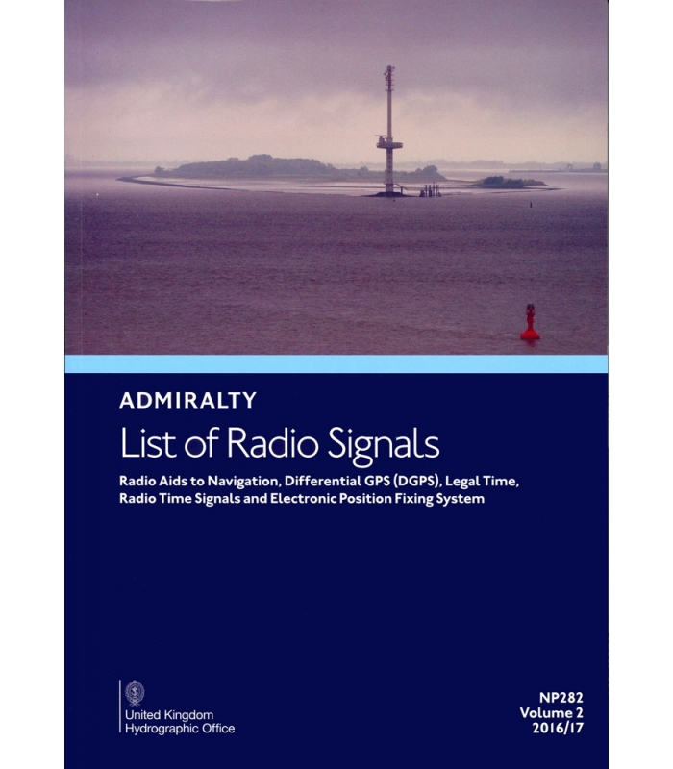
ALRS Vol II
Listing of VHF Radio Direction-Finding Stations
Radar Beacons (Racons and Ramarks)
Known operational Automatic Identification System (AIS)
Aids to Navigation (AtoN)
Radio beacons transmitting DGPS corrections
International Standard and Daylight Saving Times and Dates
International Radio Time Signal Broadcast details

Slide 22
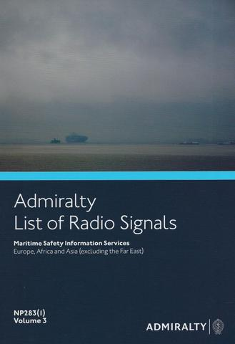
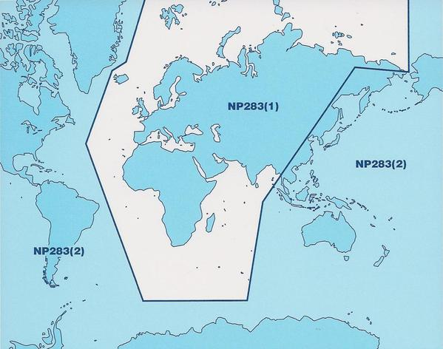
ALRS Vol III
Maritime Weather Services
Safety Information broadcasts
Worldwide NAVTEX and SafetyNET information
Submarine and Gunnery Warning details (Subfacts and Gunfacts)
Radio-Facsimile Stations, frequencies and weather map areas

Slide 23
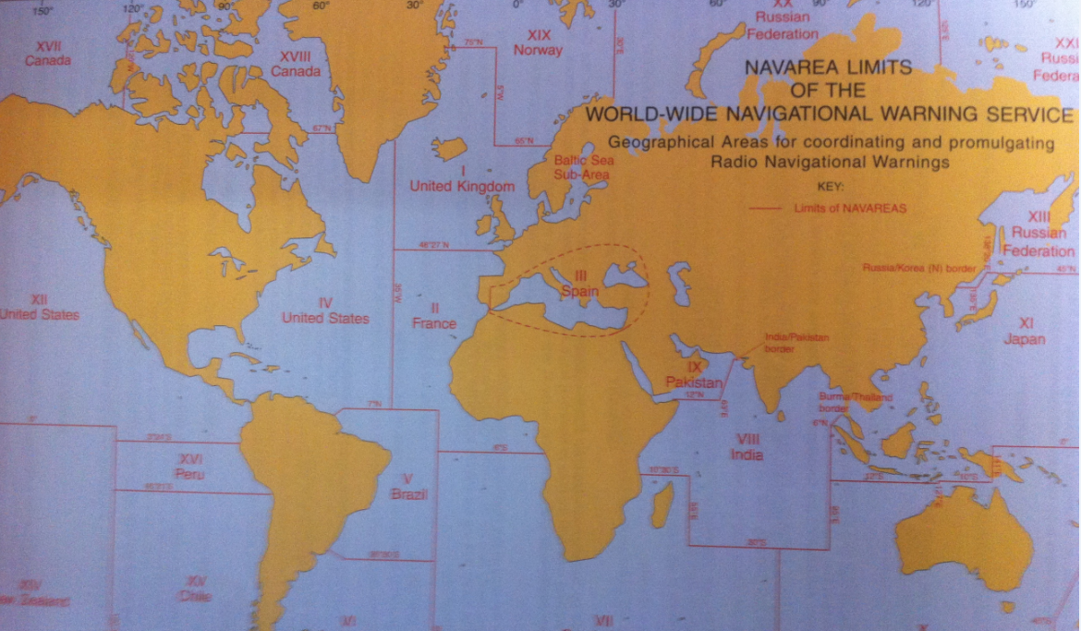

Slide 27
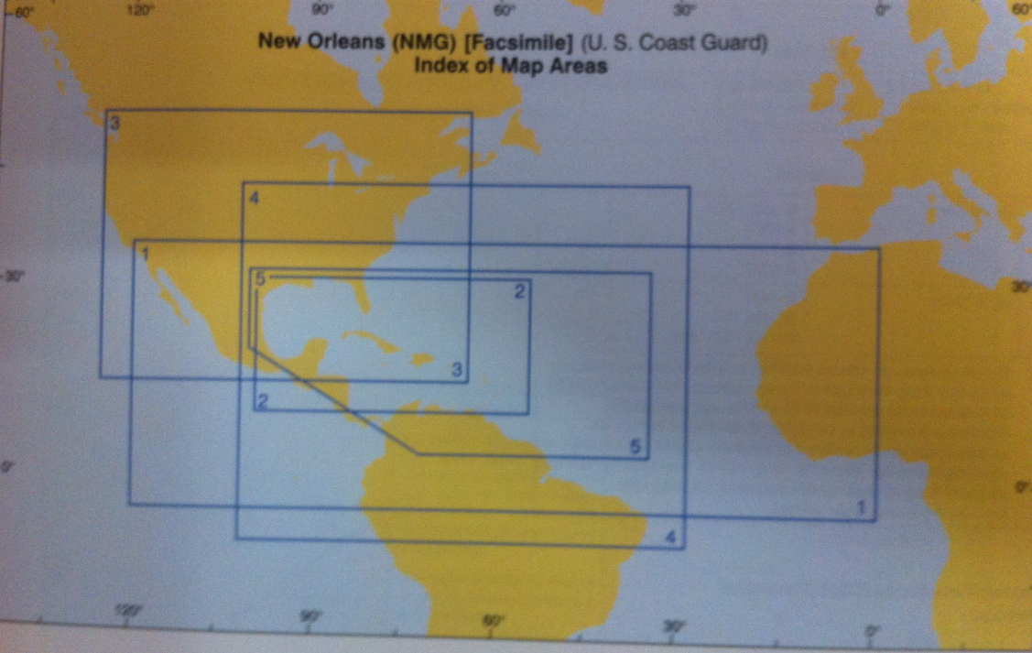

Slide 28
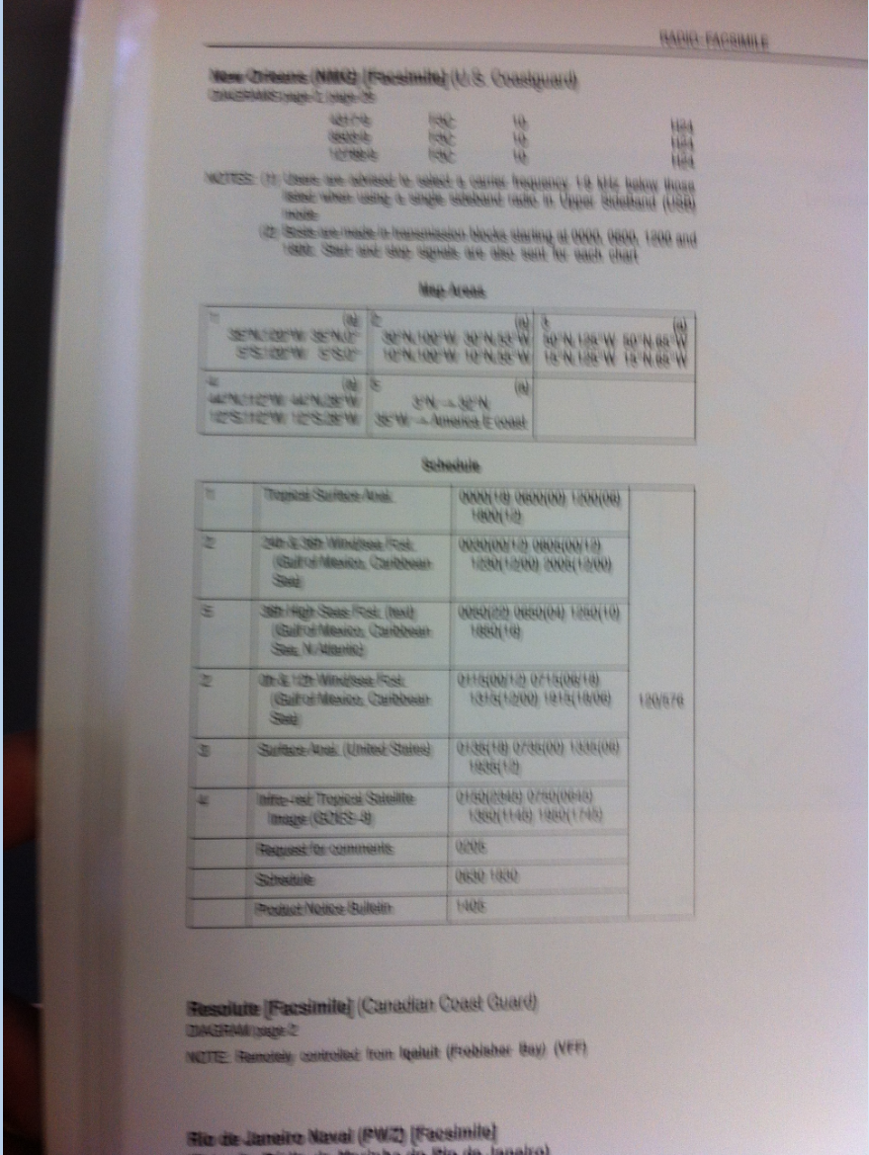

Slide 29
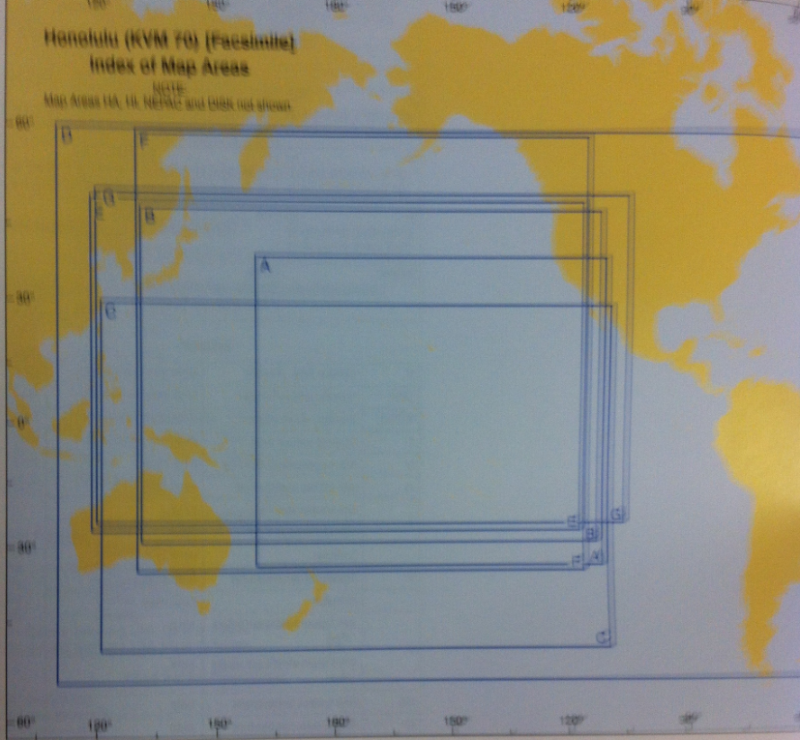

Slide 30
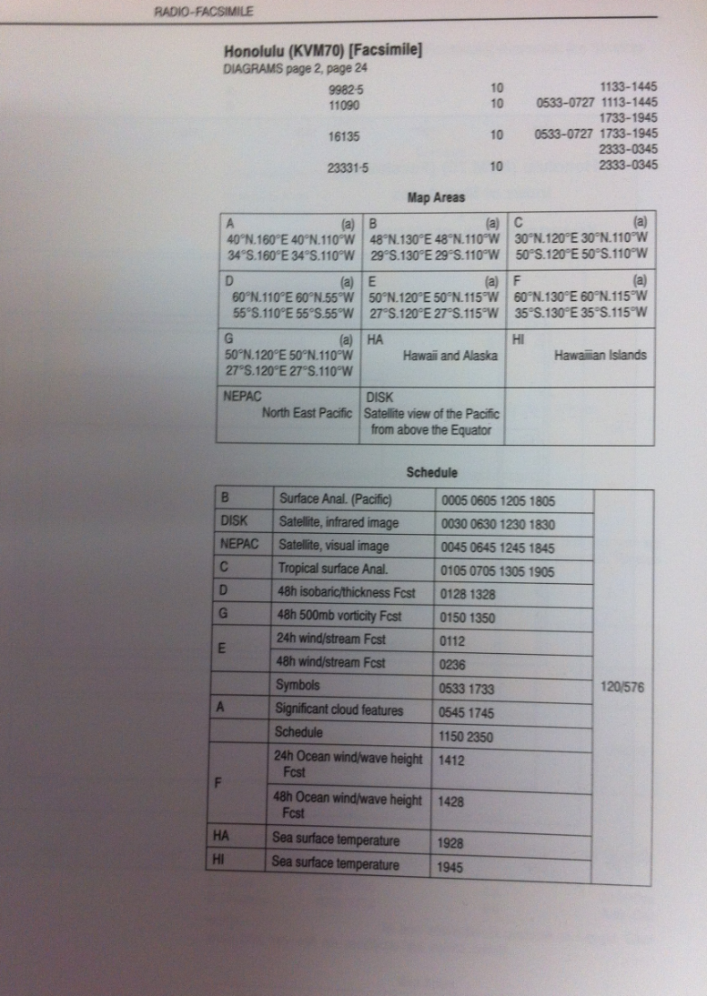

Slide 31
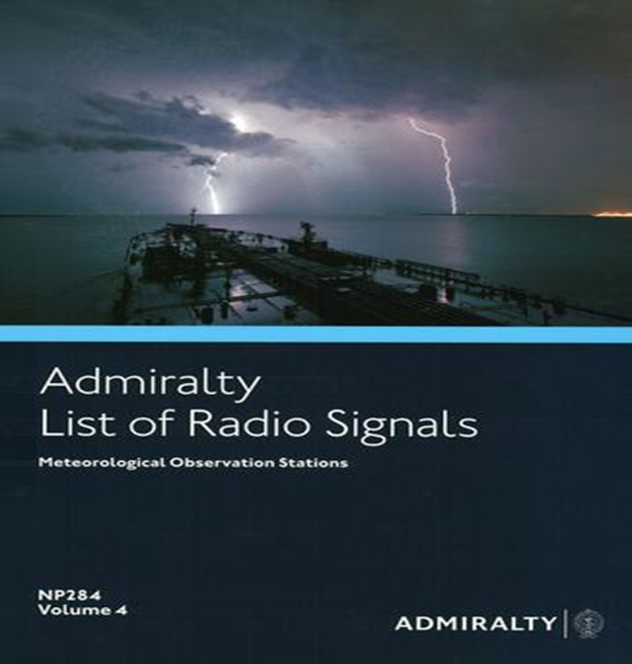
ALRS – Vol IV
All Met Observation Stations listed worldwide

Slide 32
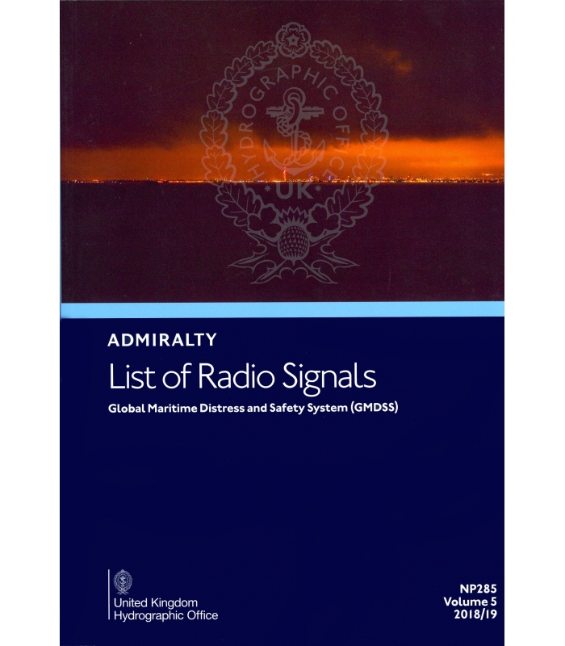
ALRS – Vol V
Worldwide communication requirements for distress, search and rescue
Extracts from SOLAS and ITU Regulations
Distress and SAR (incorporating MRCC and MRSC contacts)
Worldwide NAVTEX and Maritime Safety Information

Slide 33
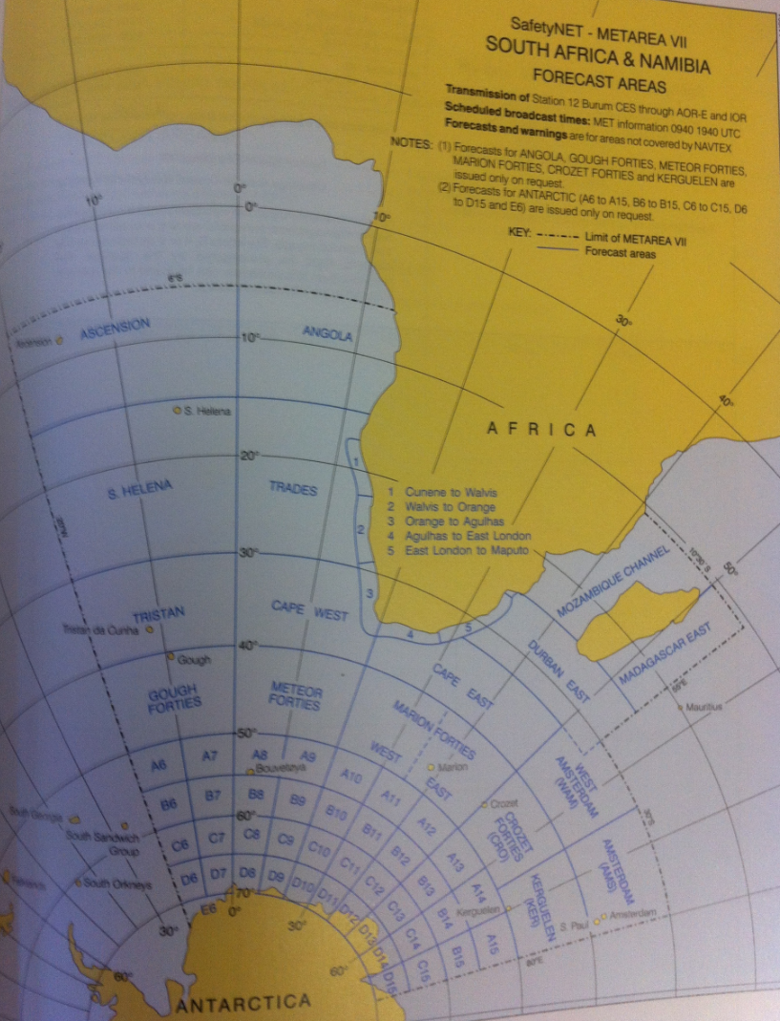

Slide 34
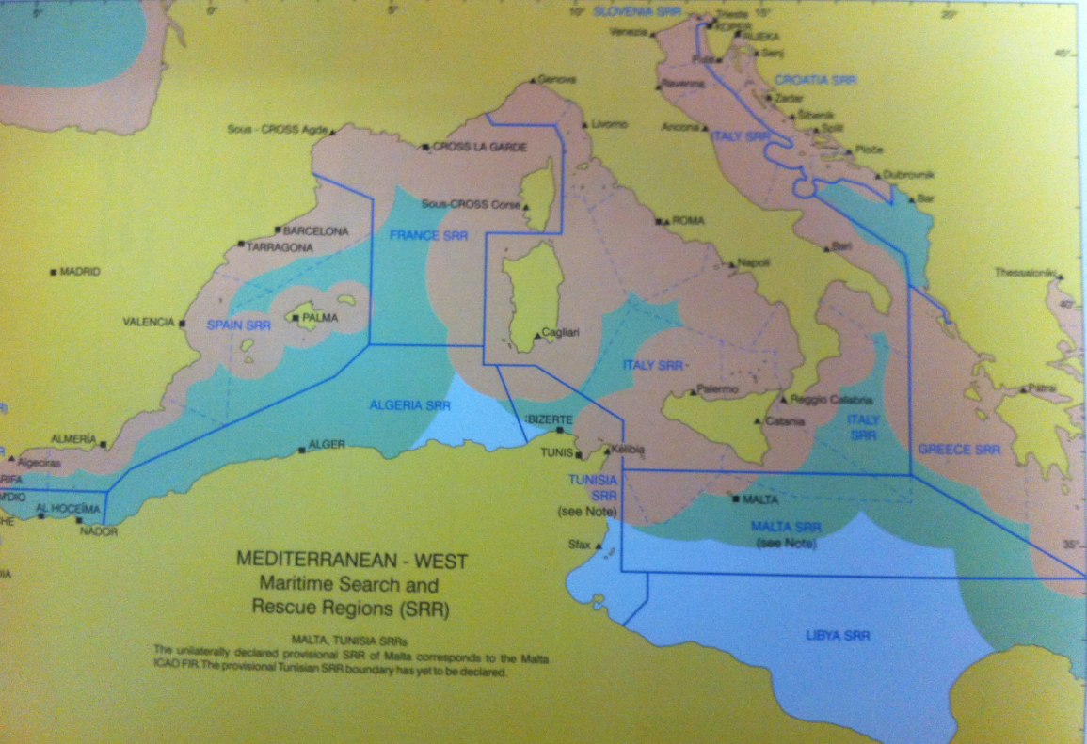

Slide 35
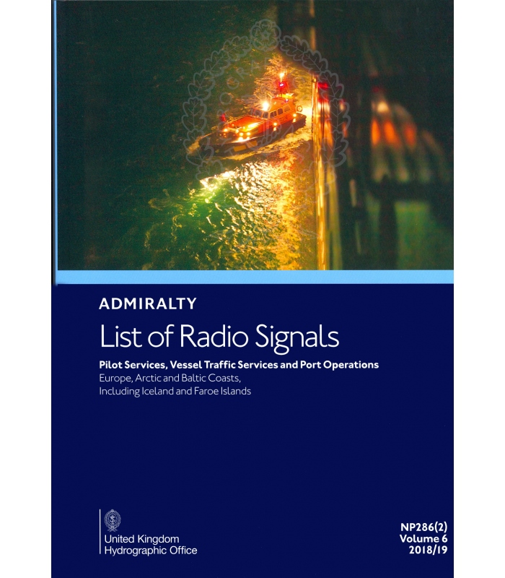
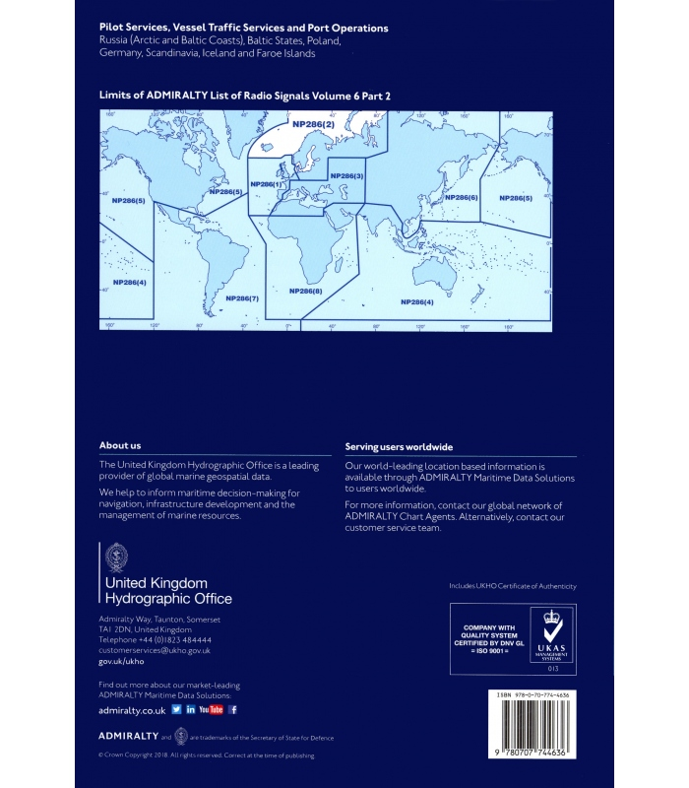
ALRS – Vol VI
Detailed Pilot information, contact details and procedures
Vessel Traffic Service information, contact details and procedures
National and International Ship Reporting Systems
Port information, contact details and procedures

Slide 36
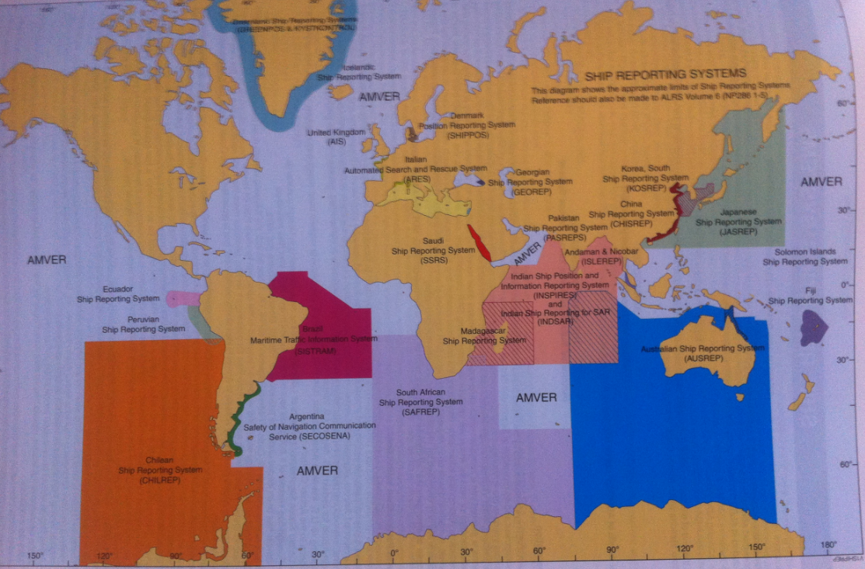
Ship Reporting Systems

Slide 38
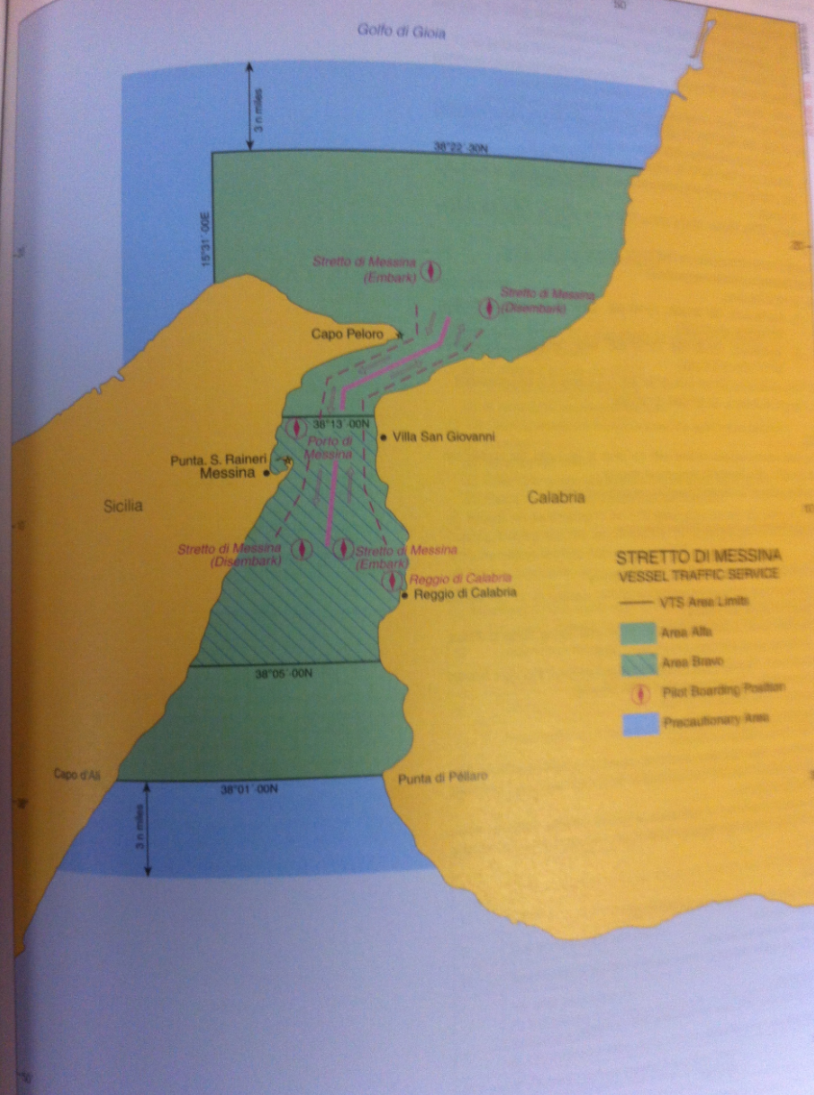

Slide 39
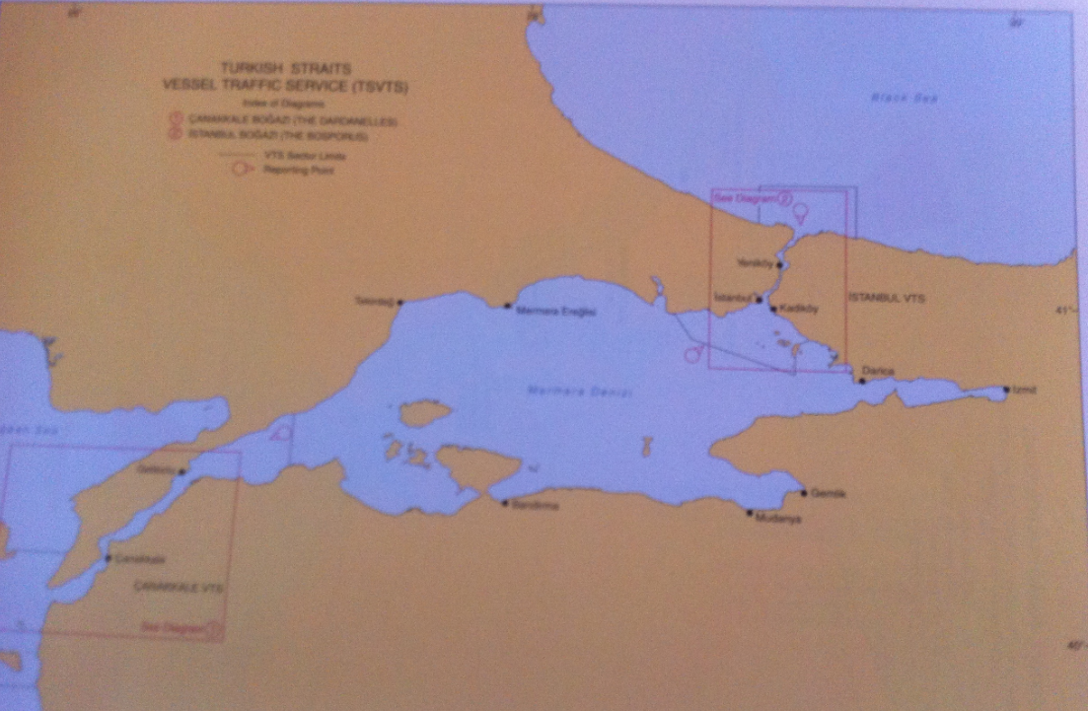

Slide 41
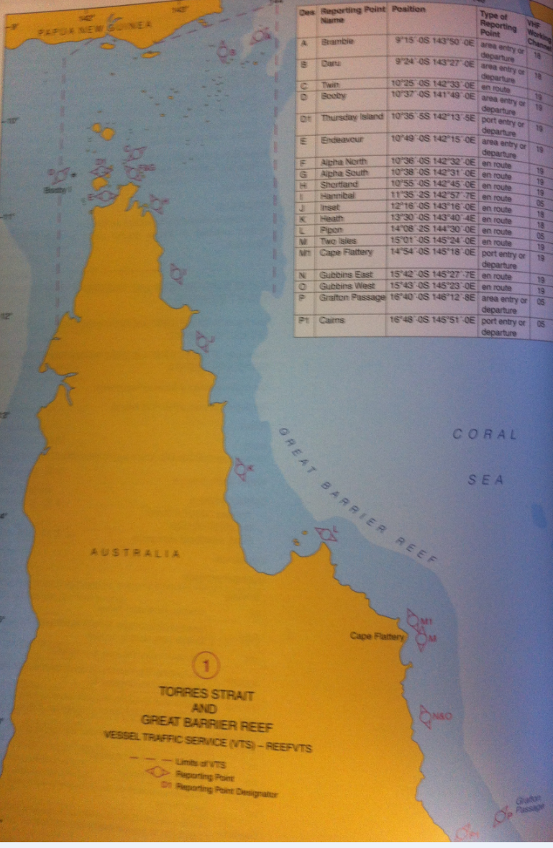

Slide 43
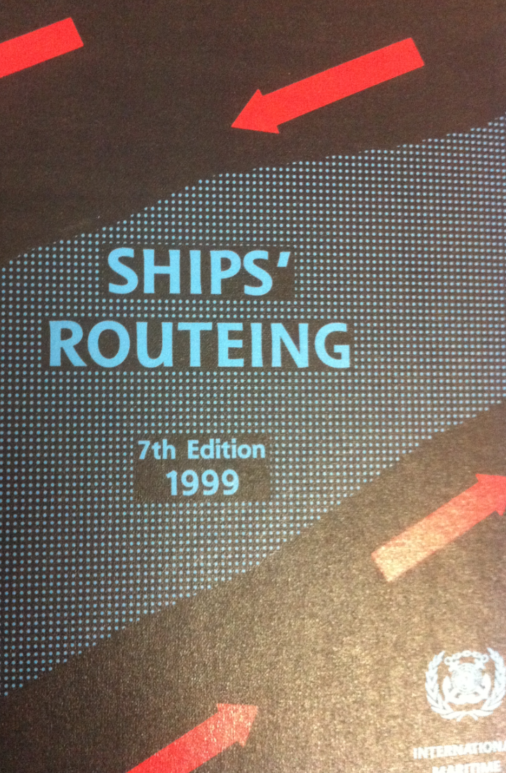

Slide 44
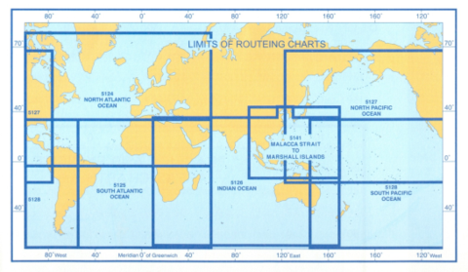

Slide 45
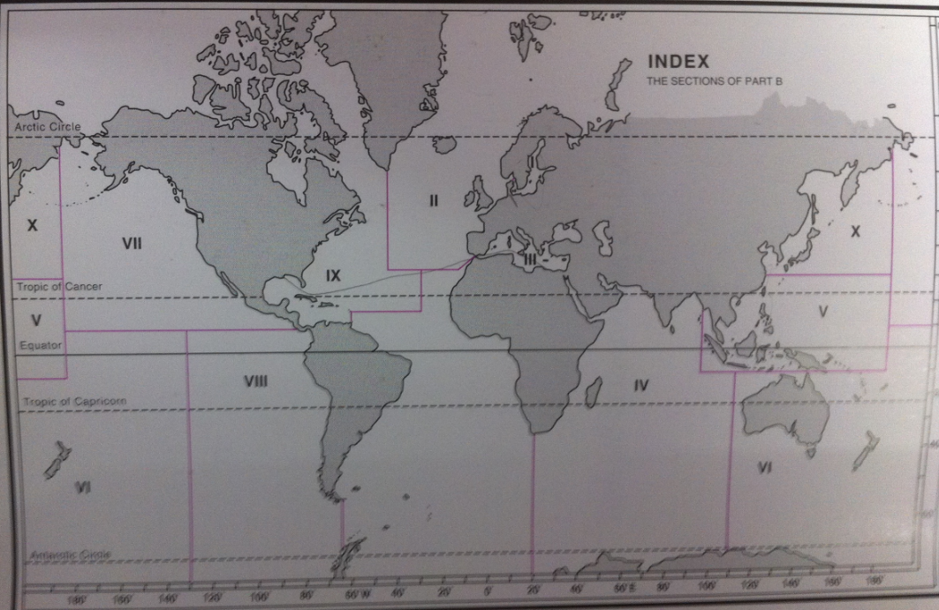

Slide 46
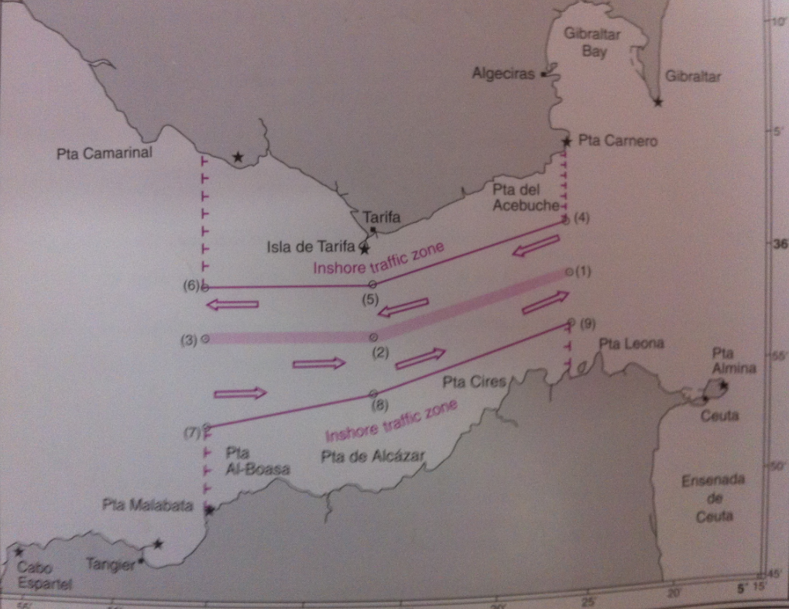

Slide 47
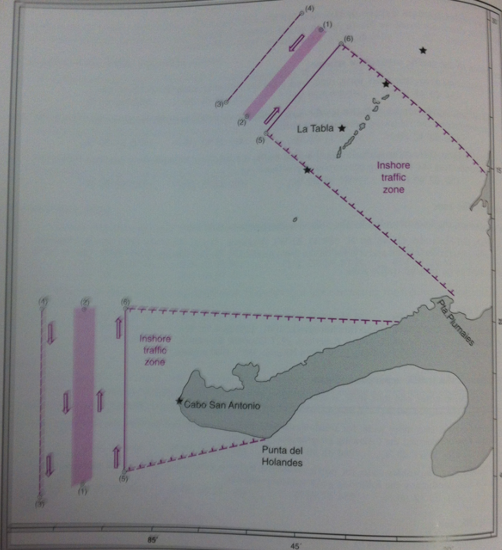

Slide 48


Slide 49


Slide 50


Slide 53


